Slide 1
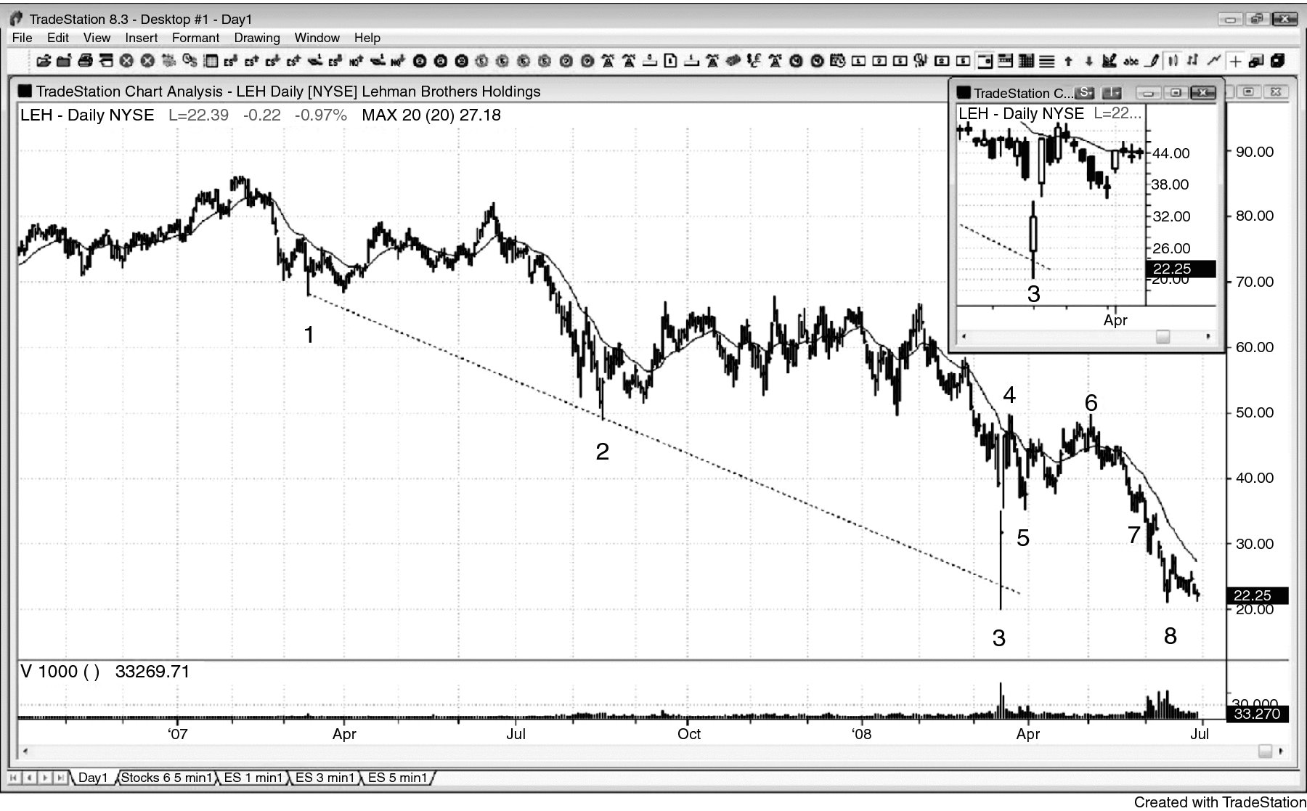
FIGURE 10.1 Huge Volume Reversal

Slide 2
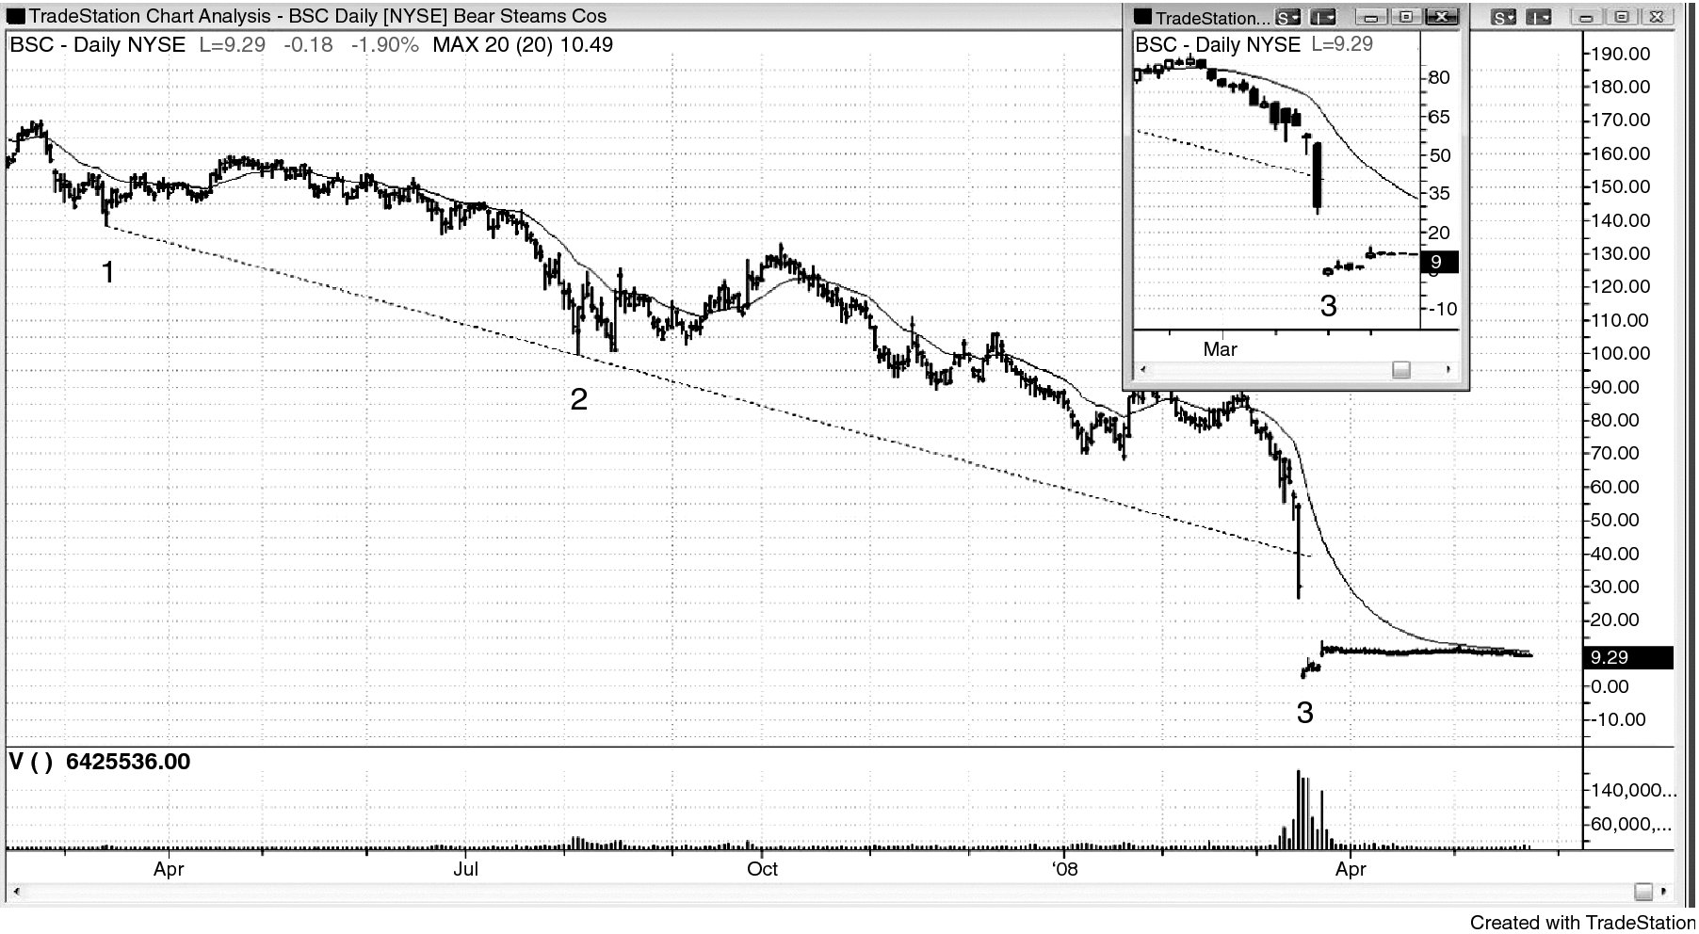
FIGURE 10.2 Huge Volume without a Reversal

